Slide 1
Entity-Relationship Model

Slide 2
Introduction to ER Model
Important components of ER model are:
Entity
Attributes
Relationships

Slide 3




Entity and Entity Sets
Student
Student Set
Mobile
Mobile Set
Entity
Entity Set

Slide 4

Entity and Entity Type
Car
Manufacturer
Model No
Model Name
Color
Cost

Slide 5
Entity and Entity Sets
Entity : an object that exists and is distinguishable from other objects. (can be identified from nouns)
Tangible : E.g. a person, a plant, a car
Intangible: E.g. a course, a bank account, a job
Entity Type: the fundamental building block for describing the structure of data /entity
Example: Book(ISBN, Title, Author Name, Revision)
Entity set: a set of entities of the same type that share the same properties
Example: set of all persons, companies, trees, holidays

Slide 6

Attributes
Written By
Director
Duration
Title
Release Date
Properties of entity
Describing words

Slide 7
Types of Attributes
Simple: attributes that are drawn from the atomic value domains
Example- name, ID, color, etc
Composite: Attributes that consist of a hierarchy of attributes
Example- Address, full name, etc
Multivalued: Attributes that have a set of values for each entity
Example- Phone number, degrees, skillsets
Derived: Attributes contain values that are calculated from other attributes
Example- age, experince

Slide 8
Simple Attributes
Employee
EID
Designation
Name
Department

Slide 9
Composite Attributes
EID
Employee
Designation
Department
Name
Address
City
Building Name
Street

Slide 10
Multivalued Attributes
Employee
ContactNo
EID
Designation
Name
Department

Slide 11

Derived Attributes
Age
Employee
DoB
EID
Designation
Name
Department

Slide 12
Relationship and Relationship Set
Relationship is an association among several entities
Relationship set is a set of relationships of same type
It is a mathematical relation among n ≥ 2 entities, each taken from entity sets.
If E_{1,} E_{2…. ,} E_{n} are entity sets, then a relationship is a subset of
{(e₁, e₂, … e_{n}) | e₁ ∈ E₁, e₂ ∈ E₂, …, e_{n} ∈ E_{n}} where (e₁, e₂, …, e_{n}) is a relationship

Slide 13
E-R Example
Entity Relation Entity
Book
Published By
Publisher

Slide 14
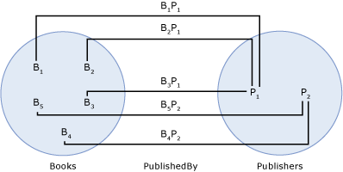
Relationship and Relationship Set

Slide 15
Degree of Relationship
Unary Relationship : When there is only ONE entity set participating in a relation
Binary Relationship : When there are TWO entities set participating in a relation
Ternary Relationship : When there are THREE entities set participating in a relation
N-ary Relationship: When there are N entities set participating in a relation

Slide 16
Unary Relationship
marries
Person

Slide 17
Binary Relationship
Student
attends
Class

Slide 18
Ternary Relationship
Employee
Works in
Department
Location

Slide 19
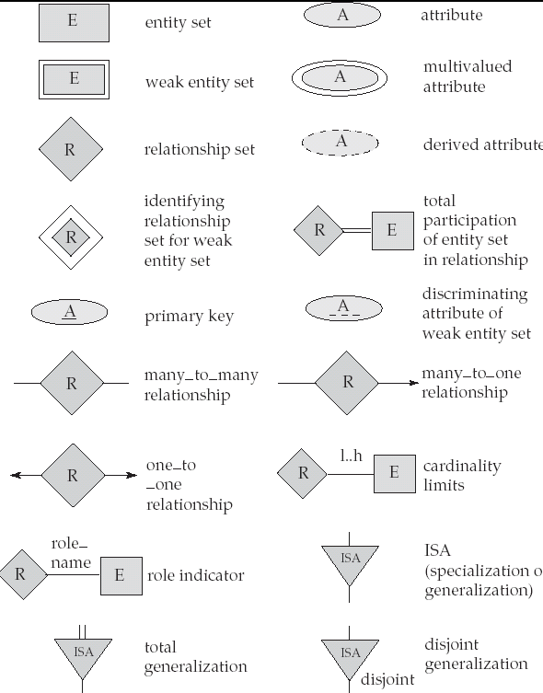
Symbols used in ERD

